Slide 1
Course: Professional Issues in IT
Course Instructor: Kashan Hussain
Email address: Kashan.Hussain@nu.edu.pk
Lec # 3&4

Slide 2
PROFESSION:
A profession is a disciplined group of individuals who adhere to ethical standards and who hold themselves out as, and are accepted by the public as possessing special knowledge and skills in a widely recognized body of learning derived from research, education and training at a high level, and who are prepared to apply this knowledge and exercise these skills un the interest of others.

Slide 3
Continuing Profession
Profession vs Occupation
Commonly people use these two words interchangeably. Are they the words meaning the same? Are they synonyms?
What is the meaning of occupation?
A person involved in a job and earning money is having that job as an occupation
Example:
A doctor teaching in a school, college or university has an occupation of teaching. A carpenter, a driver etc..

Slide 4
Differences between Occupation and Profession
A profession needs extensive training and specialized knowledge. On the other hand, an occupation does not need any extensive training.
A profession can be called an occupation when a person is paid for his particular skills, and his deep knowledge. Persons engaged in an occupation are not paid for their knowledge, but only for what they produce.
Unlike a person engaged in an occupation, a professional has to undergo higher education.
A profession tends to be autonomous, whereas, for an occupation, no one has autonomous power; he or she is supervised by another person.
Unlike occupation, a profession demands that the responsibility lies with the individual.
A profession is guided through certain ethical codes, and regulated by certain statute.

Slide 5
Characteristics of Profession
Getting to the definition of profession ; there is none called hard and fast definition. Thus professions are often associated with some characteristics briefed as following:
Mastery of an Esoteric Body of knowledge: usually acquired through higher education
A member of the profession needs this body of knowledge in order to practice
A related characteristic of professions is that they often embrace a division between researchers and practitioners

Slide 6
Characteristics………
Autonomy: Professionals generally have a great deal of autonomy, justified by having an esoteric knowledge
Professions typically have autonomy both at the collective level as well as in individual practice
Profession sets its own standards rather than taking orders or suggestion from outsiders
Formal Organization: Generally there exists a professional organization that:
Controls admission to the profession and sets standards
Involved in licensing & expelling its individual members

Slide 7
Characteristics………
Code of ethics
There is a code of ethics & members of professions must adhere to the code no matter what their employment context (take an oath)
And an important characteristic mostly taken for granted:-
Social function: Professions generally fulfill an important social function and for the welfare of the society
Medicine (promoting health)
lawyers not alone but play an important role in justice

Slide 8
PROFESSIONAL BODIES
A profession is typically organized into one or more professional bodies. What is a professional body?
A professional association (also called a professional body, professional organization, or professional society) is usually a nonprofit organization seeking to further a particular profession, the interests of individuals engaged in that profession and the public interest. OR
A professional body is a group of people in a learned occupation who are entrusted with maintaining control or oversight of the practice of the occupation
A professional body usually starts by a group of people coming together because of a shared interest in a particular type of activity.

Slide 9
Functions of Professional bodies
As the professional body matures, it is likely to develop a range of functions, of which the following are the most important:
establishing a code of conduct to regulate the way members of the body behave in their professional lives and a disciplinary procedure to discipline members who breach(fail to follow or conduct) this code;
establishing mechanisms for disseminating(spreading) knowledge of good practice and new developments to its members, typically through publications and conferences but increasingly also through the use of the worldwide web;
setting standards of education and experience that must be met by people wishing to become members of the body;
advising government and regulatory bodies about matters within its area of expertise.

Slide 10
RESERVATION OF TITLE AND FUNCTION
The use of the name of the profession may be restricted to those people who are appropriately qualified. A restriction of this sort is called reservation of title.
The law may state that certain activities are restricted to people with appropriate qualifications. This is called reservation of function.
Notes:
An example where both reservation of title and reservation of function
apply is veterinary surgery. Under the Veterinary Surgeons Act 1966, you are
not allowed to call yourself a veterinary surgeon unless you are registered
with the Royal College of Veterinary Surgeons (RCVS); in order to be registered,
you must have the proper qualifications. And, subject to certain limitations,
it is a criminal offence to carry out surgical procedures on animals
unless you are registered with the RCVS.

Slide 11
Is Computing A Profession
Where does computing fit in the process of professionalization?
What does the field of computing look like when described in terms of the mentioned characteristics?
The field of computing is so diverse and complex
The range of those who are called computer professionals is extremely broad
Nothing in common except that, in one way or another, they involve the use of computer
At first glance, it seem that computing possesses all of these characteristics, though in complex ways

Slide 12
Is Computing A Profession
Are Computer Professionals “Professionals”?
Computer professionals have mastered an esoteric body of knowledge
Computer professionals have varying degrees of autonomy depending on where they work
There is no single organization governing the profession of computing (ACM, IEEE)
Computing is an activity which supports social institutions which in turn are aimed at fulfilling a variety of social functions
Computing does not appear to be a 'profession' in the strictest sense, the way law and medicine are professions, but it is more of a 'profession' than many other occupations.

Slide 13
SOFTWARE ENGINEERING
Software engineering appears to be one area of computing that is emerging as a distinct profession within the field of computing.
This trend seems to have been created by the initiative of individuals in the field concerned about the quality and safety of the software being produced and sold.
Developing software engineering as a distinct field involves several of the activities.
For example, it means identifying a unique body of knowledge that a person must possess to be competent software engineer.
It means developing educational requirements (curriculum) such that the person who meets the requirements is more likely to produce a quality, safe software than someone without training.

Slide 14
SOFTWARE ENGINEERING
It means developing mechanisms for licensing of members.
This will include identifying or creating the proper organization for issuing licenses and identifying requirements for obtaining a license, such as passing an exam or acquiring a certain number of years of experience.
Another requirement for professionalization is a code of ethics.
The state of Texas has boldly taken the first steps in this process and has established software engineering licensing in its state.
The Texas initiative is a serious attempt at setting standards in the field.

Slide 15
SOFTWARE DEVELOPMENT AS ENGINEERING
The development of software and information systems in general is now usually regarded as a branch of engineering and the people who practice it are considered to be engineers.
Traditional engineers design and build a wide variety of objects – dams, bridges, aeroplanes, cars, radio and television transmitters and receivers, computers, plants to make fertilizer or plastics, and so on.

Slide 16
Characteristic of engineering:
There are two constraints that apply to all such activities and which can be regarded as characteristic of engineering:
First engineering involves designing and building things that must work properly, that is, must meet a set of predetermined requirements concerning their functionality, their performance, and their reliability;
the process of designing and building the object must be completed within specified constraints of time and budget.

Slide 17
THE STATUS OF ENGINEERS
The legal status of the engineering profession varies a lot from one country to another. however, the position is that:
it is illegal to call yourself an engineer in a given state unless you are registered with the State Engineers Registration Board;
it is illegal for a company to use the word ‘engineering’ in its name unless it employs at least one registered engineer;
academic programmes including the term engineering in their title must be taught mostly by registered engineers;
it is illegal to carry out engineering work except under the supervision of a registered engineer.

Slide 18
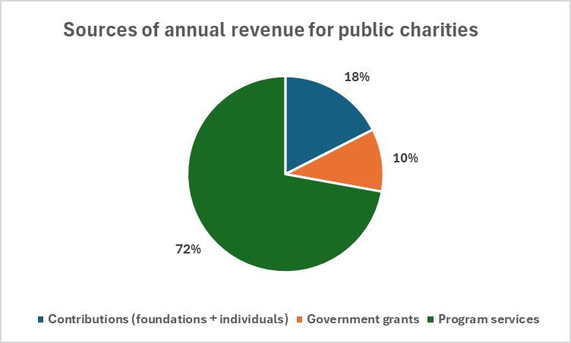
INCOME SOURCE OF NPOs
Notes:
Slide 17: Candid learnings

Slide 19
CONTINUE.. NPOs
Fees for goods and/or services
Individual donations and major gifts
Bequests
Corporate contributions
Foundation grants
Government grants and contracts
Interest from investments
Loans/program-related investments (PRIs)
Membership dues and fees

Slide 20
Bequest:is the money or property belonging to someone that they say that, after their death, they wish to be given to other people.
Program-Related Investments are a powerful financial tool used by private foundations to support charitable organizations and advance their mission.
PRIs differ from traditional grants in that they involve the use of loans, equity investments, and other financing vehicles that are expected to be repaid or generate a return on investment.
Notes:
Program-Related Investments (PRIs) | Definition, Pros, & Cons (financestrategists.com)

